Slide 1
Project 2
UC Berkeley
Health Monitor
User Interface

Slide 2
Idea
Create a web application to control various health indicators and medications efficiency.
Basic functionality:
Authentification: a possibility to create a user’s account and logging in to our website;
Summary Health: a possibility to keep information about all medications that our user is taking (names, doses, schedule for taking medications) and to download basic information (e.g. main side effects, drug interactions, composition, rules for taking of these medications, etc.) about these medications from different DBs (or APIs);
User’s Indicators Control
Calendar: a possibility to choose a date to put the information related to some indicators;
Alerts: to send alert emails to take medications and to fill the information in our website;
Visualization: to create some graphs for indicators monitoring (indicators dynamics, etc.).

Slide 3
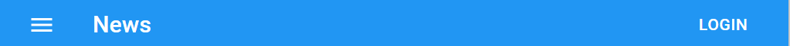
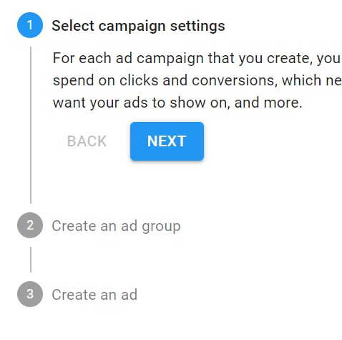
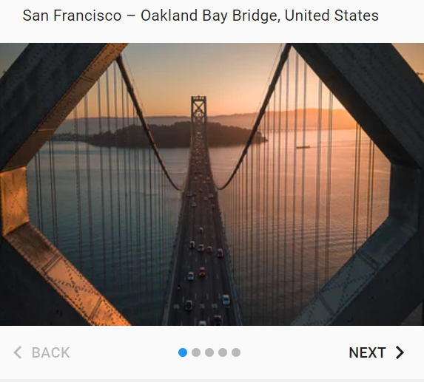
Health Monitoring App
SIGN IN OR SIGN UP
If user press this button he/she will see the authentication page (see slide 4)
Main Information about the App with some pictures (examples of graphs, reports, etc.)
A Simple Guide with Info for the users:
Sign In or Sign Up
Tell us About You (name, age, sex, etc.)
Add your indicators to monitor

Slide 4
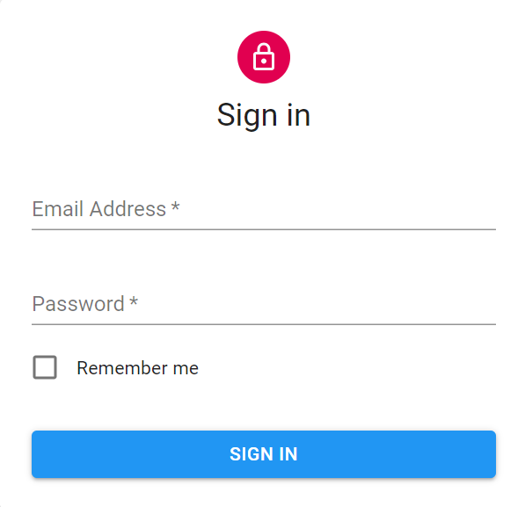

Health Monitoring App
SIGN IN OR SIGN UP
User should enter the data to sign in or press sign up button to register and “Forgot Password” button to send the data to their email (registration page see on slide 5, password reminder - slide 6)
Forgot Password
SIGN UP

Slide 5
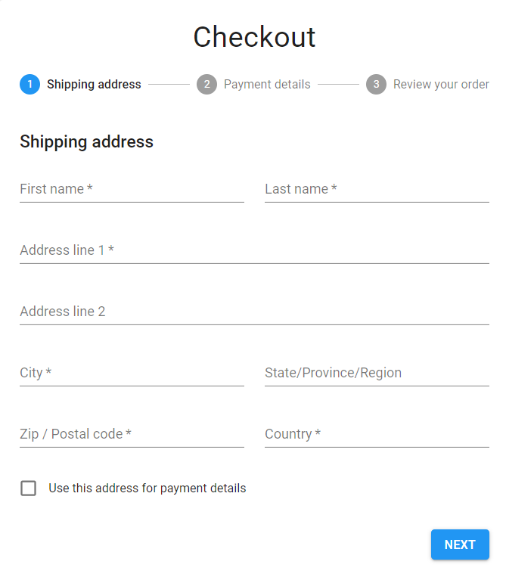
Health Monitoring App
SIGN IN OR SIGN UP
Registration
User must enter:
name, age, sex, weight, height, etc.;
main health issues (diagnoses, info about medications);
define indicators for monitoring
Basics
Health Summary
Your Indicators
Personal Data
Age*
Sex*

Slide 6

Health Monitoring App
SIGN IN OR SIGN UP
Reset Password
New Password *
Confirm Password *
SEND

Slide 7
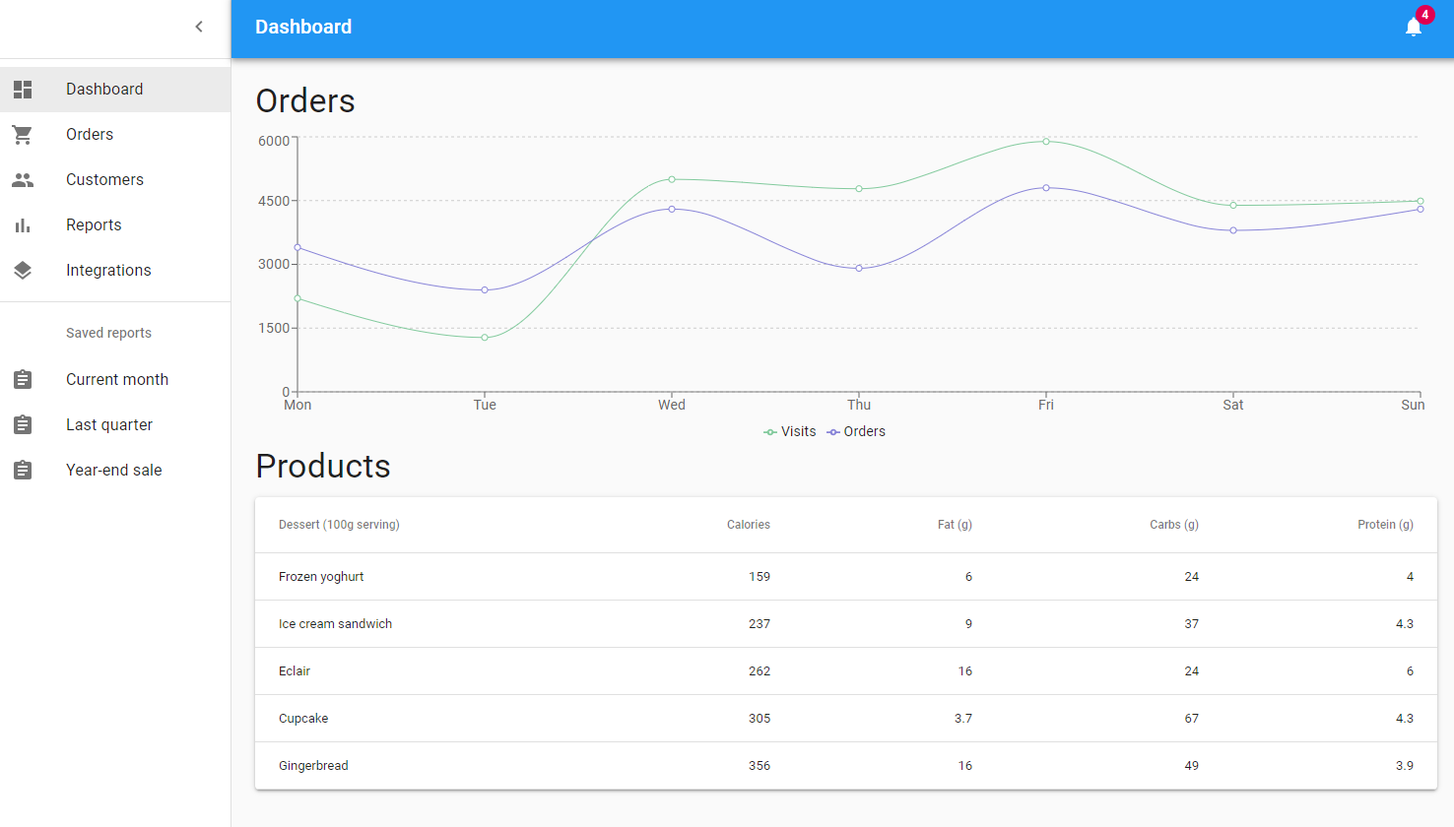
MY ACCOUNT | LOG OUT
Daily Weight
Indicators
Medications
The main window of the authorized user

